Slide 1
Stereo Depth Estimation
Ishan Gupta, Asavri Kaur, Vasilis Pteris, Alexandra Ukrainskaya

Slide 2
Project Outline - SGBM
The Semi-Global Block Matching (SGBM) algorithm was chosen superior level of detail and accuracy in textured environments compared to alternative methods.
Translation of C++ logic into HLS compatible code
Hardware-software targeting FPGA fabric
Optimisation of HLS to target optimal performance

Slide 3
Specific Aims
Throughput
Potential scope to achieve real time depth estimation of 161 ±10% FPS at 1080p resolution, to meet deterministic timing requirements of high-speed optical systems.
Resource Utilisation
Optimise resource efficiency to ensure the design fits below a utilisation maximum threshold of 70% for BRAM, DSP, LUT and FF.
Speedup Validation
Quantify a speed up of 10x times the benchmarked software runtime to demonstrate the efficiency of custom hardware accelerated cost aggregation paths.
Disparity Map Validation
Verify correctness of the output disparity maps against benchmarked C++ code and known test images.
https://www.xilinx.com/support/documents/sw_manuals/xilinx2022_2/ug949-vivado-design-methodology.pdf
FP-Stereo: Hardware-Efficient Stereo Vision for Embedded Applications | IEEE Conference Publication | IEEE Xplore

Slide 4
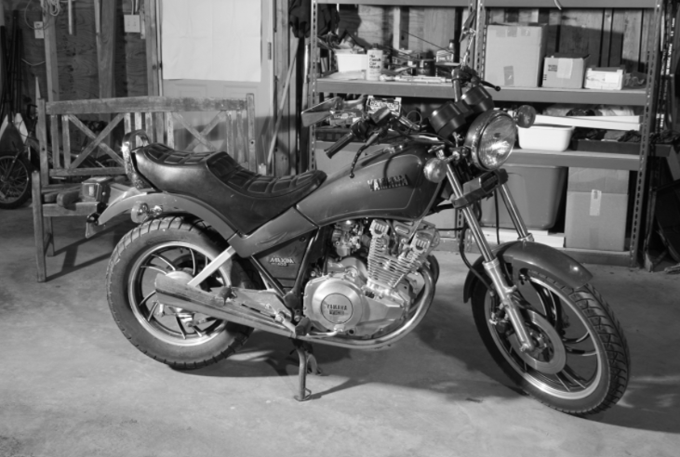
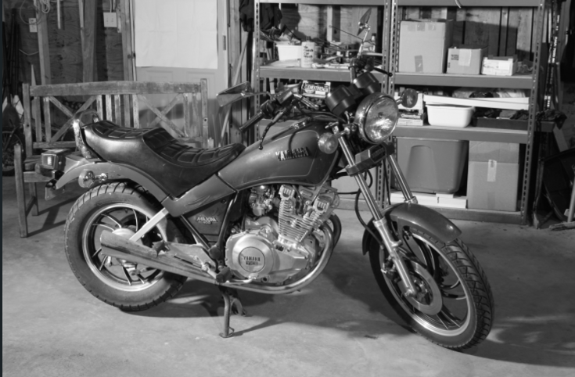
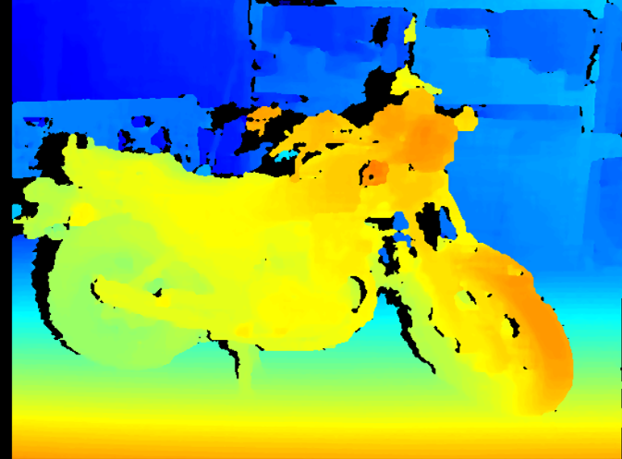
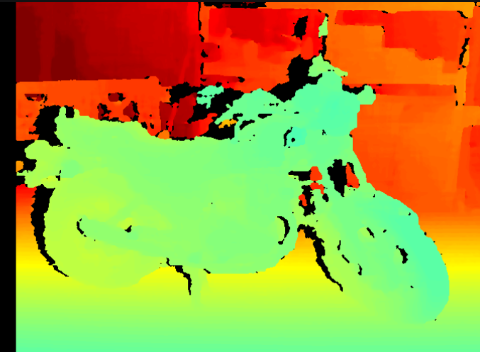
Algorithm to be accelerated – Asavri/Ishan
PROGRAM StereoDepth
left, right ← load stereo pair
fx, baseline, doffs ← load calibration
resize images to 25%
disparity ← SGBM(left, right) // pixel shift per point
FOR each pixel:
IF disparity > 0:
depth ← baseline × fx / (disparity + doffs) // mm
save disparity map, depth map, raw depth
END
Left image
Right image
Disparity map
Software Implementation
--- Timing (741x500, maxDisp=80) ---
load images: 300.679 ms
resize + save: 19.3048 ms
SGBM (cold): 35.8756 ms
SGBM best of 10: 28.8824 ms (12.8279 Mpix/s)
depth conversion: 2.4578 ms
visualize + save: 262.639 ms
Depth map

Slide 5
Investigation so far - Alexandra
SGM has offers great speed/accuracy trade-off among local/global/semi-global stereo matching algorithms[1]
General stereo depth camera pipeline is capture → calibrate → rectify → stereo matching (SGM) → disparity-to-depth triangulation [2]. The pipeline for stereo matching (SGM), which we are going to accelerate, is cost →aggregation → disparity → refinement[3].
Existing FPGA solutions: Vitis Vision Library[5] has PL implementation of functions that may be used for stereo vision; FP-stereo open-source library for stereo camera pipelines[5].
Global optimization causes heavy memory pressure on hardware (large intermediate results, irregular access) → cost aggregation is the FPGA bottleneck [6]
[1]H. Hirschmuller, "Stereo Vision in Structured Environments by Consistent Semi-Global Matching," 2006 IEEE Computer Society Conference on Computer Vision and Pattern Recognition (CVPR'06), New York, NY, USA, 2006, pp. 2386-2393, doi: 10.1109/CVPR.2006.294.
[2] R. Szeliski, Computer Vision: Algorithms and Applications, 2nd ed. Cham, Switzerland: Springer, 2022, ch. 11-12.
[3] R. A. Hamzah and H. Ibrahim, "Literature survey on stereo vision disparity map algorithms," Journal of Sensors, vol. 2016, Art. no. 8742920, 2016, doi: 10.1155/2016/8742920.
[4] AMD, "Stereo Vision Pipeline," Vitis Vision Library, version 2023.2, Dec. 2023. [Online]. Available: https://docs.amd.com/r/2023.2-English/Vitis_Libraries/vision/overview.html_3_5.
[5] J. Zhao, T. Liang, L. Feng, W. Ding, S. Sinha, W. Zhang, and S. Shen, "FP-Stereo: Hardware-efficient stereo vision for embedded applications," in Proc. 30th Int. Conf. Field-Programmable Logic and Applications (FPL), 2020.
[6] W. Wang, J. Yan, N. Xu, Y. Wang, and F.-H. Hsu, "Real-time high-quality stereo vision system in FPGA," in Proc. Int. Conf. Field-Programmable Technology (FPT), Kyoto, Japan, 2013, pp. 358–361, doi: 10.1109/FPT.2013.6718387.

Slide 6
Project Plan (Milestones & Timeline)
Benchmarking PS (Completed end of week 5)
Implementing on PL (Complete end of week 7)
Optimizing PL (Complete end of week 8)
Peripheral Integration (Stereo Cameras) [Complete end of week 8/ongoing into week 9]
Report (Ongoing, due week 10)

Slide 7
Risks and Contingencies - Asavri
Risk | Likelihood | Impact | Mitigation
SGM cost aggregation exceeds on-chip memory (BRAM) | H | H | Reduce disparity range/resolution (quality validated in SW at 0.25×); 4 aggregation paths instead of 8; fall back to local BM (xf::cv::StereoBM)
HLS kernel misses timing / throughput target | M | M | Lower clock or parallelism; use proven Vitis Vision SemiGlobalBM IP as baseline, custom kernel as stretch
No physical stereo camera | M | L | Full pipeline runs on Middlebury dataset pairs
Integration overrun (tool/board issues, schedule) | M | H | Staged deliverables. Each stage is independent. SW -> HLS -> on board -> live camera integration
H = High, M = Medium, L = Low
xilinx.github.io/Vitis_Libraries/vision/2022.1/index.html
2014 Stereo Datasets OpenCV: cv::StereoSGBM Class Reference

Slide 8
Team Roles
Ishan Gupta – Set up platform, Test on board, Replace with real kernel, Clock tuning and pipeline optimisation.
Asavri Kaur – ARM program, ARM verification, Kernel timing, Pixels-per-clock optimisation testing.
Vasilis Pteris – Kernel in csim, circuit verification, SGM in KV260 and Unroll + Partition sweep testing.
Alexandra Ukrainskaya – Build depth map verification tool, Write printable C++ algorithm, Board output verification, Different data type sizes optimisation testing.

